Slide 1
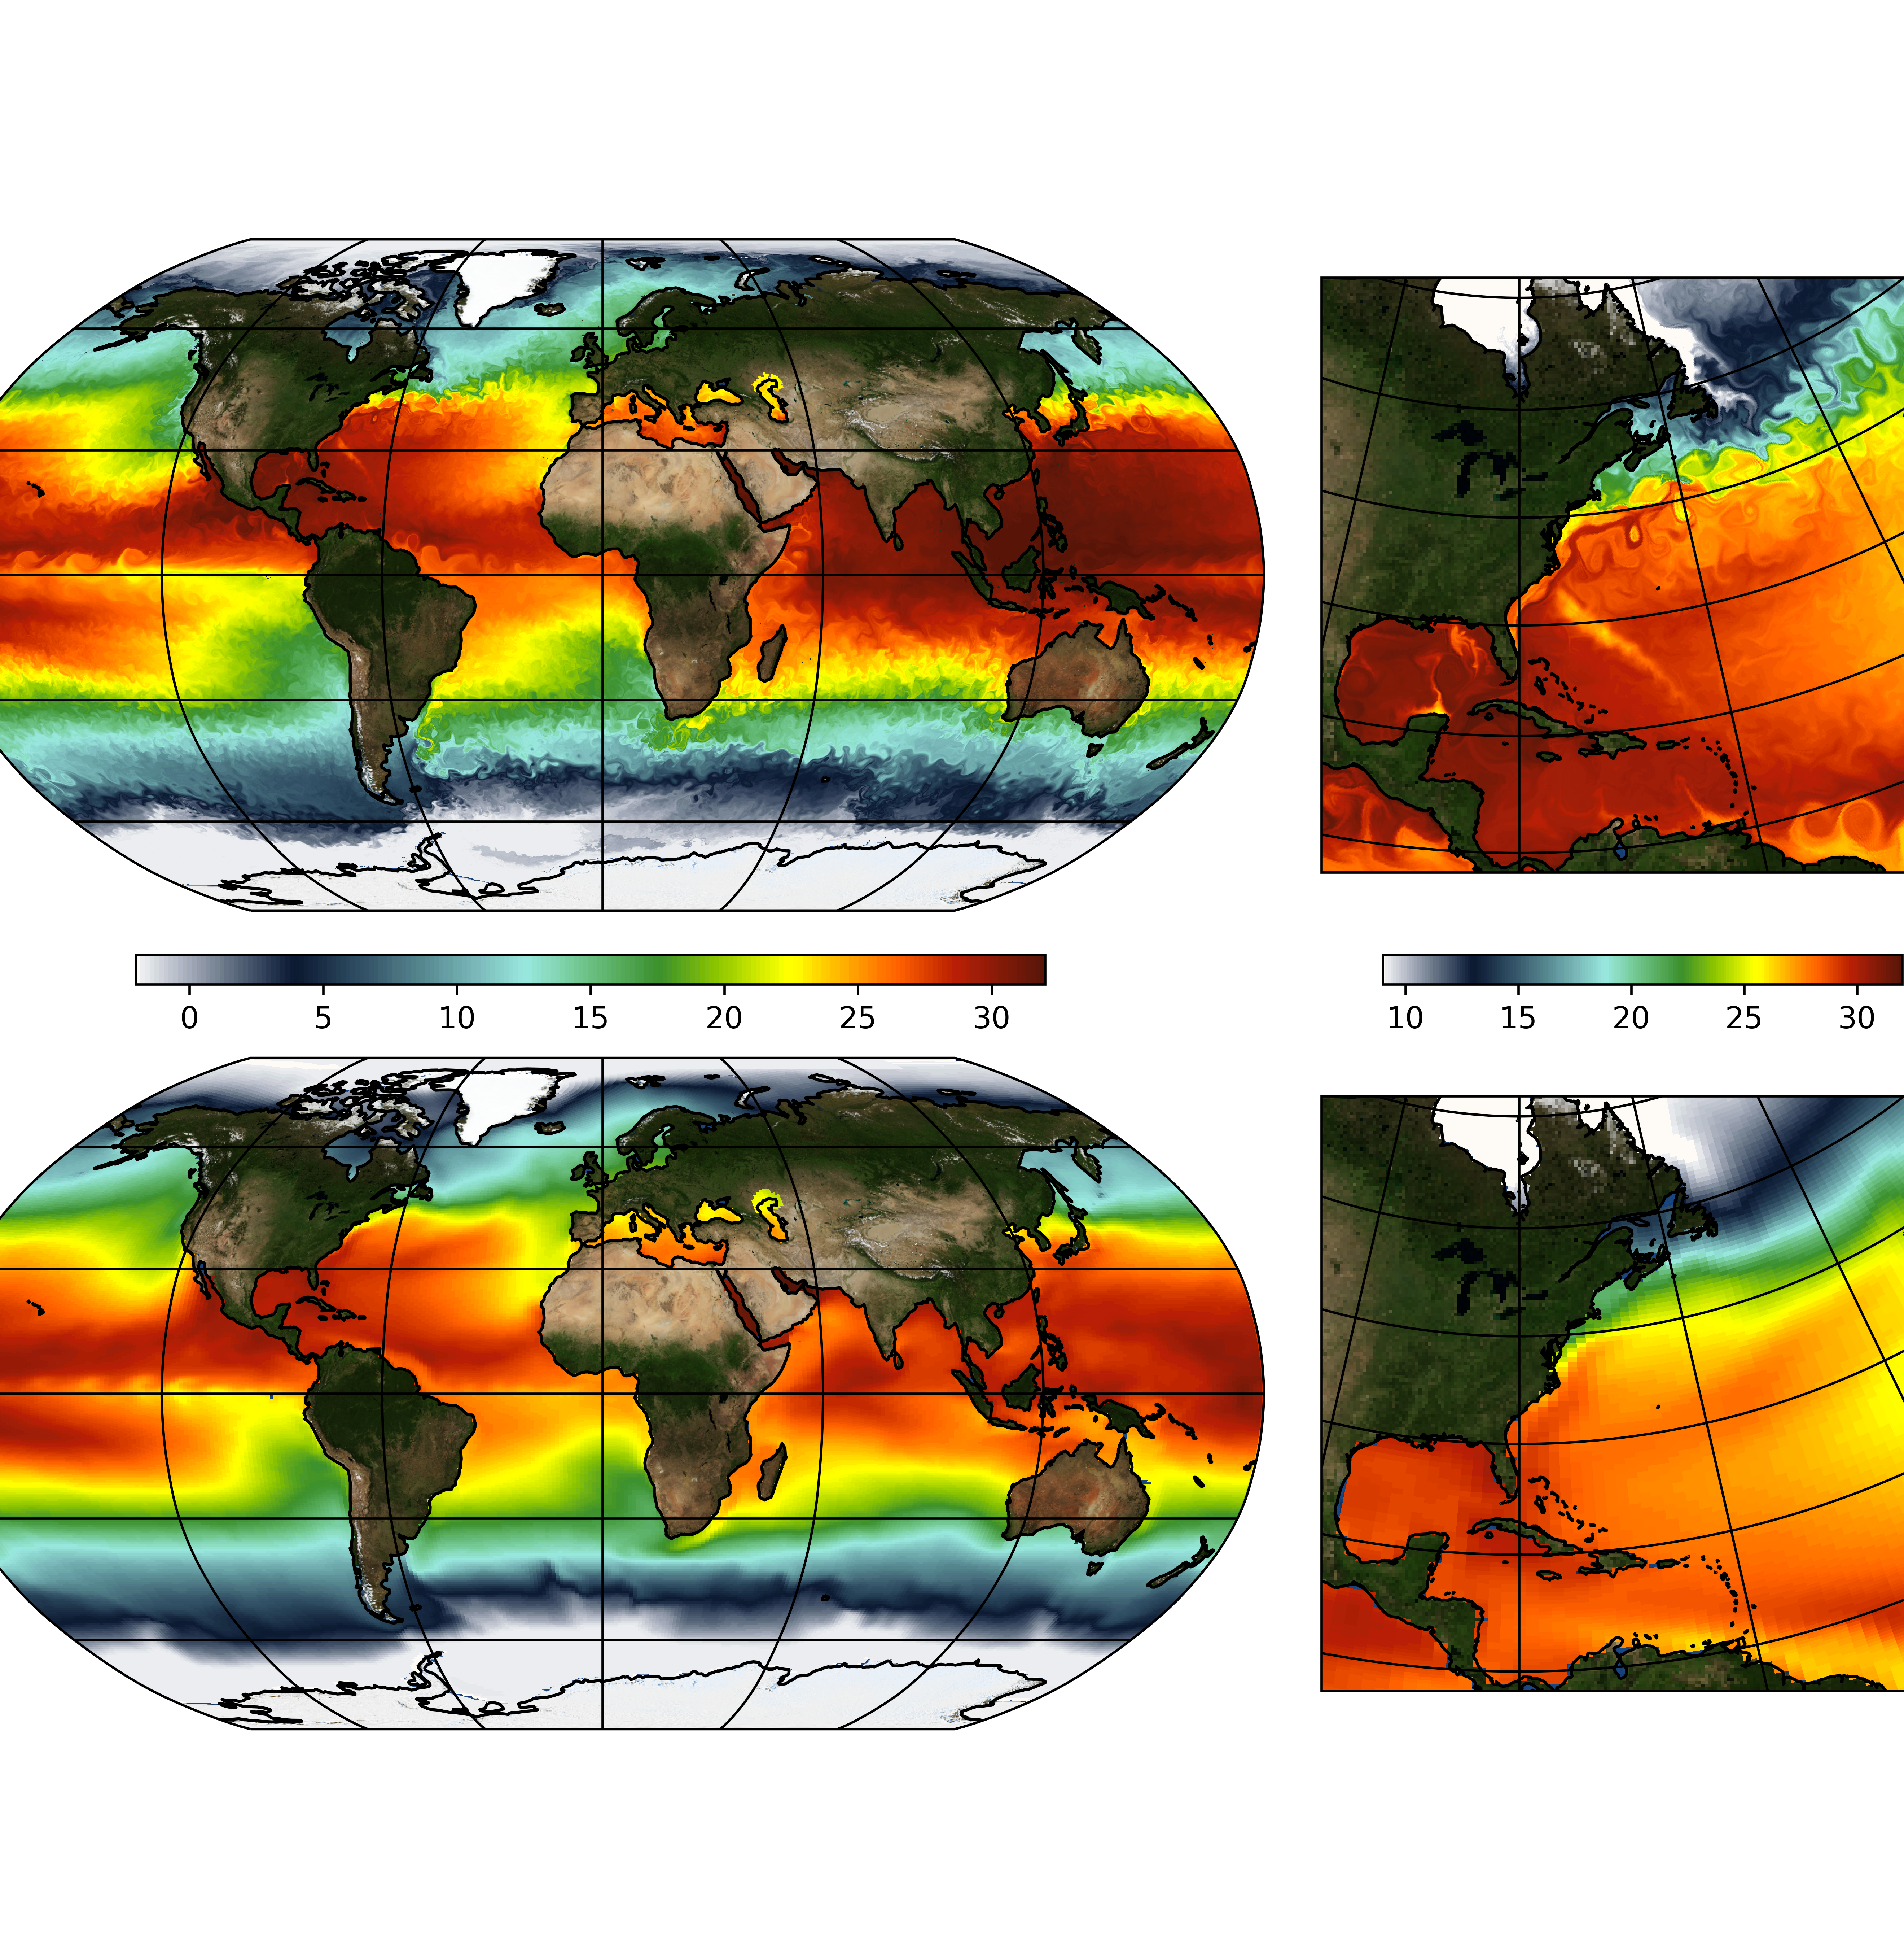

An Unprecedented Set of High-Resolution Climate Simulations from the International Laboratory for High-Resolution Earth System Prediction (iHESP) P. Chang^{1,4}, S. Zhang^{2,4}, G. Danabasoglu^{3,4} + iHESP Team
0.25º-0.1º CEMS1.3
Importance & Motivation:
Assess and quantify the role of mesoscale ocean eddies and weather extremes, such as tropical cyclones, and their interactions with large-scale circulations in climate variability and change, prediction and projection by carrying out an unprecedented set of long climate simulations at mesoscale eddy- and tropical cyclone-permitting resolutions (0.1º ocean and 0.25º atmos).
P. Chang (ping@tamu.edu)
S. Zhang (szhang@ouc.edu.cn)
G. Danabasoglu (gokhan@ucar.edu)
Texas A&M University (TAMU)
Qingdao National Lab. for Marine Sci. &Tech. (QNLM)
National Center for Atmospheric Research (NCAR)
Int. Lab. for High-Res. Earth System Prediction (iHESP)
1º CEMS1.3

Slide 2
Present & Future Tropical Cyclones in HR vs. LR
(2006-2100)-(1877-2005)
(2006-2100)-(1877-2005)
Highlights:
Number of TCs is greatly improved in HR over LR, although many biases remain in HR
Projected TC change in HR shows a northward shift of TC activity in the North Pacific with a reduced TC activity in the South Indian Ocean and Eastern Pacific
Notes:
Finally, I’d like to show a few results for tropical cyclone simulations. The left 3-panels show the observed global TC tracks during 1950-2018. Color indicates CT strength and numbers show annually averaged TCs in each basin. The similar maps in the middle and bottom panels show the simulated TCs in HR and LR. Clearly, the overall TC numbers increase drastically in HR compared to LR. However, even with this improvement in overall TC numbers, many model biases remain in HR. For example, the TC strength remains to be weaker than observation. HR simulates too many TCs in the Southern Hemisphere but too few TCs in the North Atlantic. The right 2-panels show the projected TC changes in the future by subtracting the TC track density averaged over the historical period of 1877-2005 from that over the future period of 2006-2100. The upper panel shows the HR result, while the lower panel shows the LR result. Clearly, we see more changes in HR than in LR. In particular, there is an indication of northward shift of TC activity in the western North Pacific, but a reduced TC activity in the South Indian Ocean and the Northeastern Pacific. The reduction in TC activity in the South Indian is consistent among many models in the HighResMIP project.

Slide 3
Summary
(See Chang et al. 2020 in JAMES for details: https://doi.org/10.1029/2020MS002298)
Improvements in HR over LR:
Global-mean SST and T2m
Mixed layer depth and SST annual cycle
N. Atlantic meridional heat transport at 26.5°N and AMV
Tropical cyclones
Atmospheric Rivers
No improvements in HR:
ENSO
MJO
Deterioration in HR:
Sea-ice extent and concentration
ACC transport at Drake Passage
Rainfall bias along the ITCZ
Lesson learned:
TOA imbalance in HR
Minimum of 150 to 200 years of model spin-up even in HR
Data availability:
PI-CTRL (first 310 years): https://ihesp.tamu.edu or http://ihesp.qnlm.ac
HighResMIP: https://cera-www.dkrz.de/WDCC/ui/cerasearch/cmip6?input=CMIP6.HighResMIP.NCAR.CESM1-CAM5-SE-HR
More release coming soon
Notes:
In summary, we see many improvements in the eddy-rich and TC-permitting CESM simulation over the standard resolution CESM simulation. The examples shown in this presentation include a more realistic simulation of global mean sea-surface temperature and surface air-temperature, a more realistic mixed layer depth and SST annual cycle, an improved North Atlantic meridional heat transport at 26.5N and a more realistic simulation of Atlantic Multidecadal Variability, as well as much improved tropical cyclone and atmospheric river simulations. We also show that some phenomena show little or no changes to horizontal resolution increase. For example, we see no significant changes in simulated ENSO cycle. We also don’t see any significant changes in the simulated MJO in HR and LR run. It is also worth pointing out that not everything is improved by increasing model resolutions. In fact, some aspects of HR simulation are deteriorated from LR simulation. For example, sea-ice extent and concentration are underestimated compared to LR and becomes more unrealistic. ACC transport in HR is too weak compared to LR and observations. Rainfall bias along the ITCZ is increased in HR simulation. In terms of lessons learned from our first experience with conducting a large set 16 of high‐resolution climate simulations, it is clear that tuning TOA imbalance in HR models is much more difficult than in LR models because of exceedingly high computational cost. We also learned that even for HR models, a long model spin-up is required to achieve stable climate. We see significant model drift in the first 150 years of PI CTRL, suggesting a minimum of 150-200 years of model spin-up is probably required. Finally, I’d like to point out that some of the simulation datasets shown in this presentation have already been released. The first 300 years of PI-CTRL is available via these web links. The entire HighResMIP datasets are released via ESGF shown in this link. And we will be releasing more datasets to the community by the end of this year or early next year. Thank you again for listening this presentation and I will be available on Dec 10 to answer any questions.

